Slide 1
Smart Traffic Signal Simulator
Subject: Foundations of Programming
Course Code:
Teacher name: Dr. Renuka Mane
Div: 3
Batch: C2
Team members: Om Jadhav – 1262252682
Niharika Singh – 1262253874
Yanika Phatak – 1262251867
Shriya Shelke - 1262252710

Slide 2
INTRODUCTION AND TECHNOLOGIES USED
INTRODUCTION | TECHNOLOGIES USED
Traffic congestion has become a major issue in urban areas due to the increasing number of vehicles on roads. Most traditional traffic signal systems operate on fixed time intervals, regardless of the actual traffic density at an intersection. This often leads to unnecessary waiting time, fuel wastage, and increased pollution. | C Programming Language GCC / Turbo C Compiler Libraries: i) stdio.h ii) stdlib.h iii) string.h Console-based simulation

Slide 3
ProBlem statement and objectives
What’s the problem? | What’s the objective?
Conventional traffic signal systems suffer from several limitations: Fixed signal timing doesn’t consider real-time traffic conditions. Unnecessary long green signals for roads with fewer vehicles. Traffic congestion on roads. No special priority for emergency vehicles. Traffic imbalance leads to delays, fuel wastage, and frustration. | To design and implement a smart traffic signal simulation using C programming. To dynamically allocate green signal time based on traffic density. To prioritize emergency vehicles by giving them immediate green signal. To simulate real-world traffic decision-making using simple logic.

Slide 4
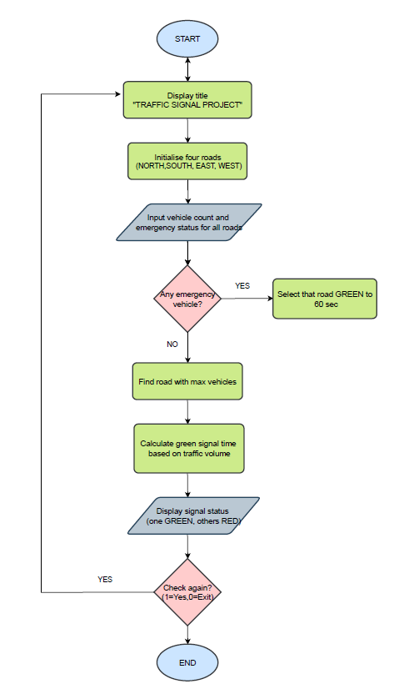
ALGORITHM
Step 1: Start the program
Step 2: Initialize roads
Step 3: Begin infinite loop
Step 4: Take input
Step 5: Check for emergency vehicle
Step 6: Find maximum traffic
Step 7: Assign time based on traffic
Step 8: Display signal status
Step 9: Repeat or exit
FLOWCHART

Slide 5
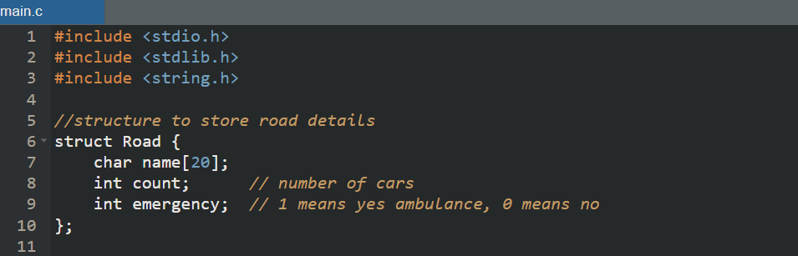
Structure used
We include stdio.h for printing, stdlib.h to clear the screen, and string.h to handle the road names.
struct Road acts as a container to store road data.
name → Road name
count → Number of cars
emergency → 1 if ambulance present, else 0

Slide 6
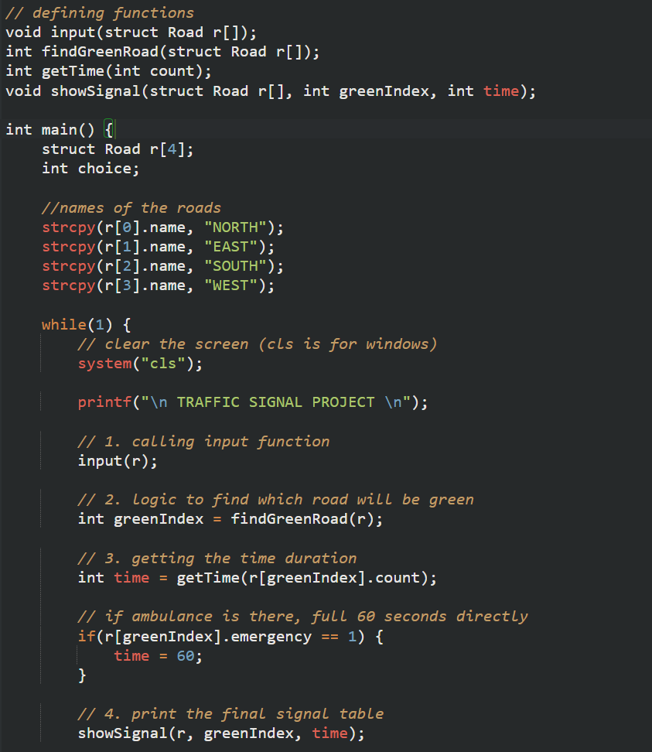
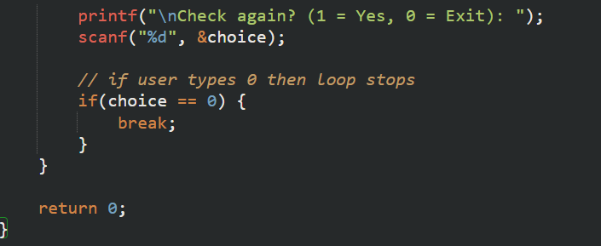
Main Function & Road Initialization
Here, an array of 4 roads is created, i.e NORTH, EAST, SOUTH, WEST.
Names are assigned using strcpy(). This is because we can't use = for words in C.
while(1) creates a continuous running system. (infinite loop)

Slide 7
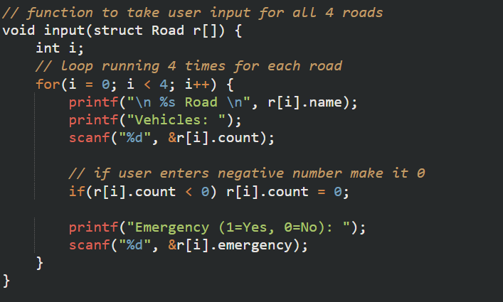
Taking input for vehicle count
A for loop is used here. (runs 4 times).
We take the car count and emergency status.
Incase a user enters a negative value, it gets corrected to 0. This ensures valid data input.

Slide 8
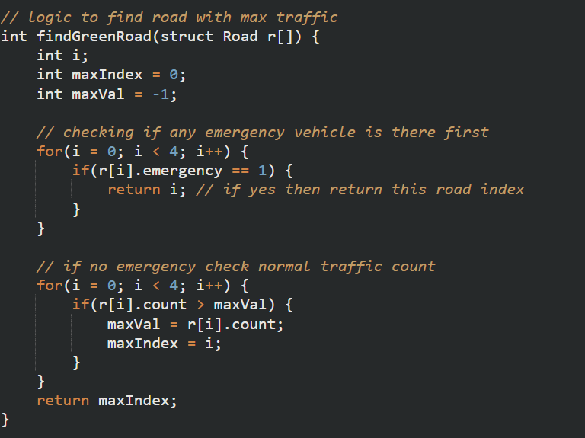
Green Signal Logic (Core Logic)
This is the smartest part of the code.
Step 1: We check emergency first. If an emergency vehicle is present on any road, it ignores the vehicle count on other roads.
Step 2: If there is no emergency, the road with maximum number of cars is chosen to give the green light to.

Slide 9
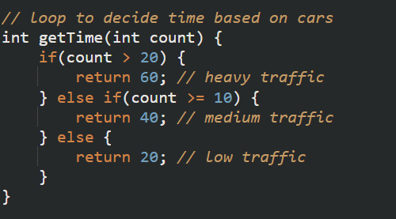
Time Allocation Logic
This is a simple logic to decide the green light duration.
Heavy Traffic (>20 cars): 60 seconds
Medium Traffic (10-20 cars): 40 seconds
Light Traffic (<10 cars): 20 seconds

Slide 10
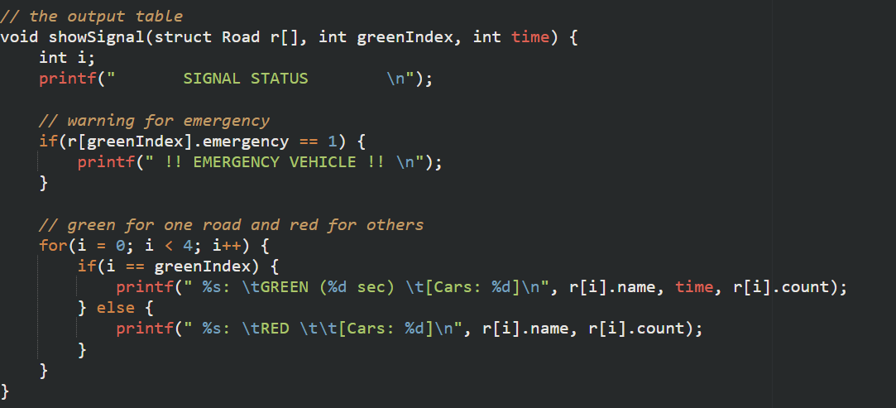
The display
Here, we loop through the 4 roads.
The selected road prints GREEN along with the time.
The other roads print RED.
Then we display the formatted output table.

Slide 11
Conclusion & Future Scope
CONCLUSION | FUTURE SCOPE
In this project, we successfully developed a Smart Traffic Signal System simulation using C programming. The system intelligently determines which road should receive the green signal based on two main factors: emergency priority and traffic density. | Integration with real-time traffic sensors. AI-based prediction of traffic patterns. Integration with smart city infrastructure. Adding pedestrian crossing management. Using cameras for vehicle detection instead of manual input.

Slide 12
THANK YOU

